Slide 1
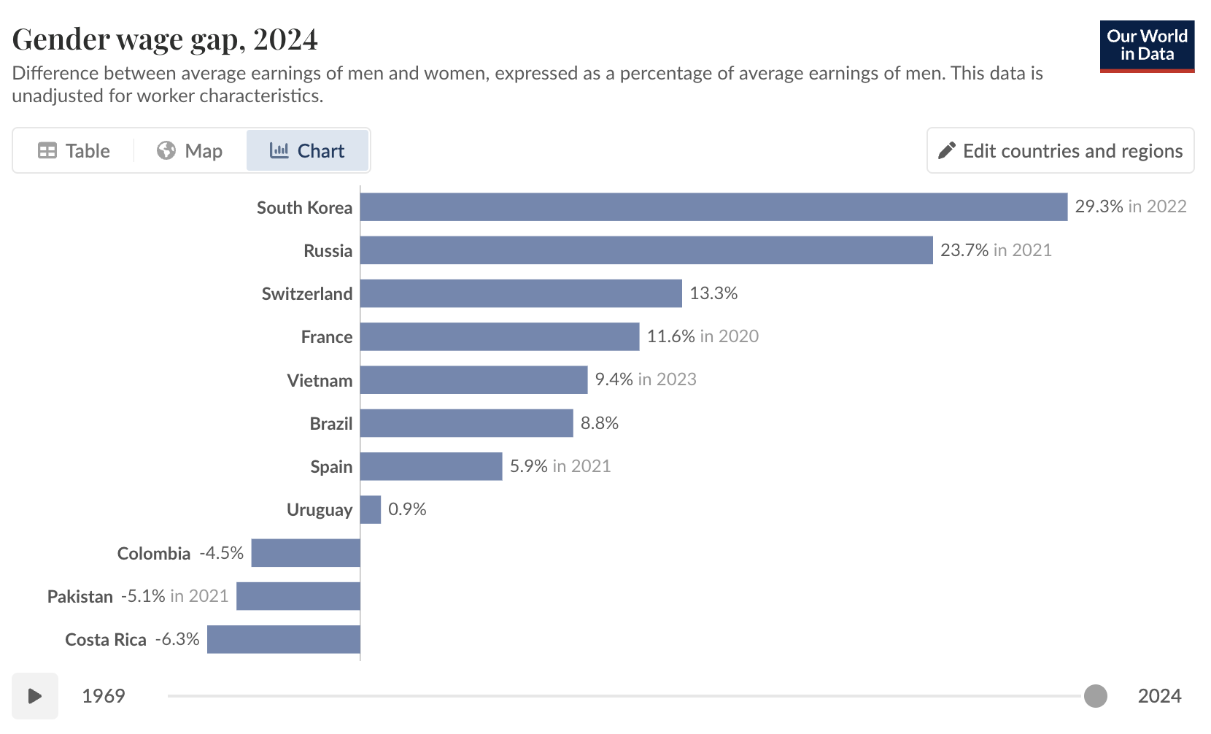
What do you think are the causes of the gender pay gap?

Slide 2
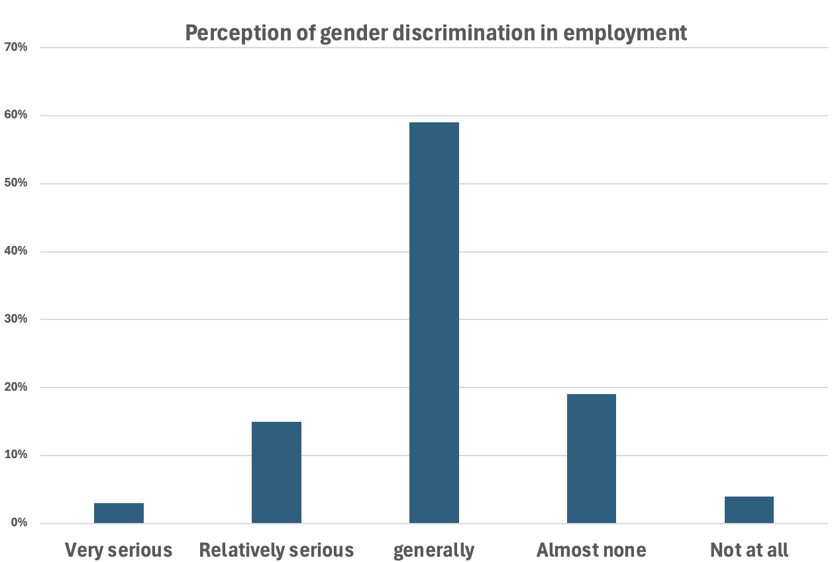

gender discrimination

Slide 3

Male-Female facts and fallacies article: Thomas sowell Economic Facts and Fallacies
By: Jingliang Lu

Slide 4

content
Causes
  The widely held reason (discrimination) – fallacies
  The two main factors - Facts
Conclusion
  Why do fallacies arise？
Q&A

Slide 5
Part 1
Causes

Slide 6
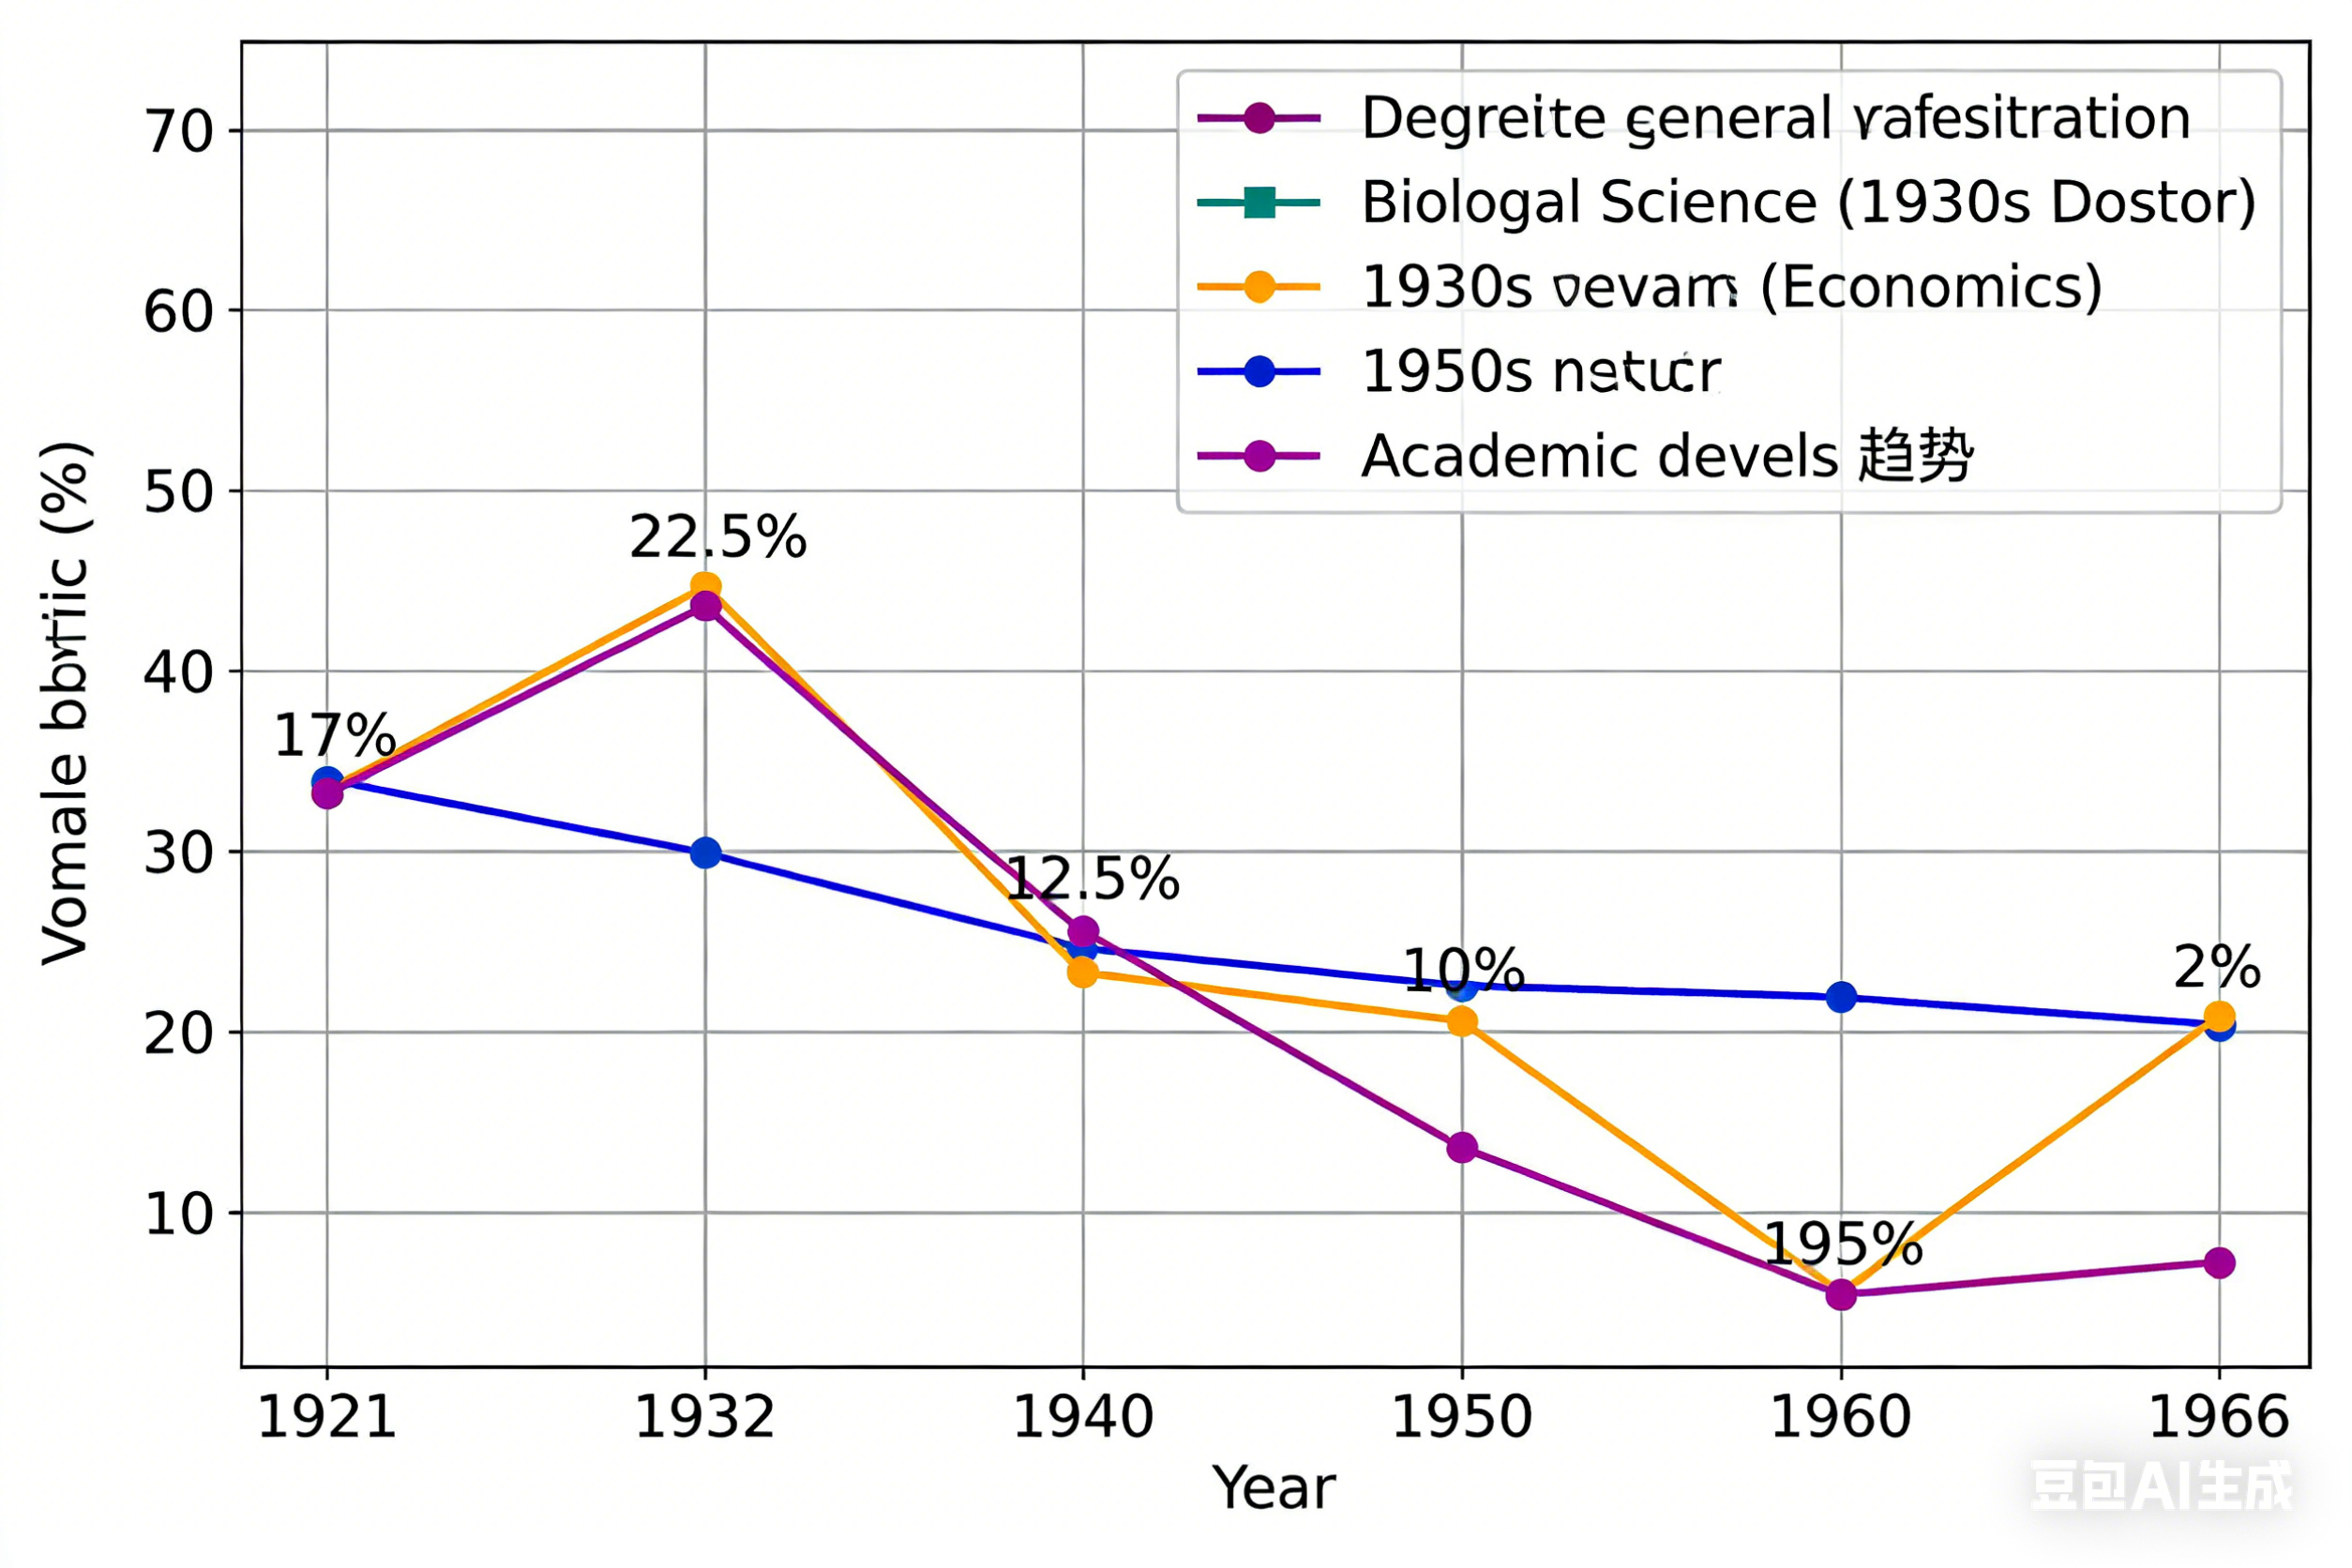
Is it all due to gender discrimination?
Contradictory fact
1. anti-discrimination
laws and policies imposed by government in the 1960s
2. Declines in the representation of women among academic faculty during
this era occurred even at women's colleges, run by women
Declines in Higher Education and Professional Occupations

Slide 7

Male vs. Female Comparison
physiological perspective
Weaker physical strength
Stronger physical strength
Social responsibilities
greater societal responsibility for childbearing and childcare.
family responsibilities are more focused on external pursuits.
Individual tendencies
Their personality and emotional tendencies are characterized by stability and a low-stress orientation.
have a stronger professional ambition and tend to choose high-pressure, high-reward careers.

Slide 8
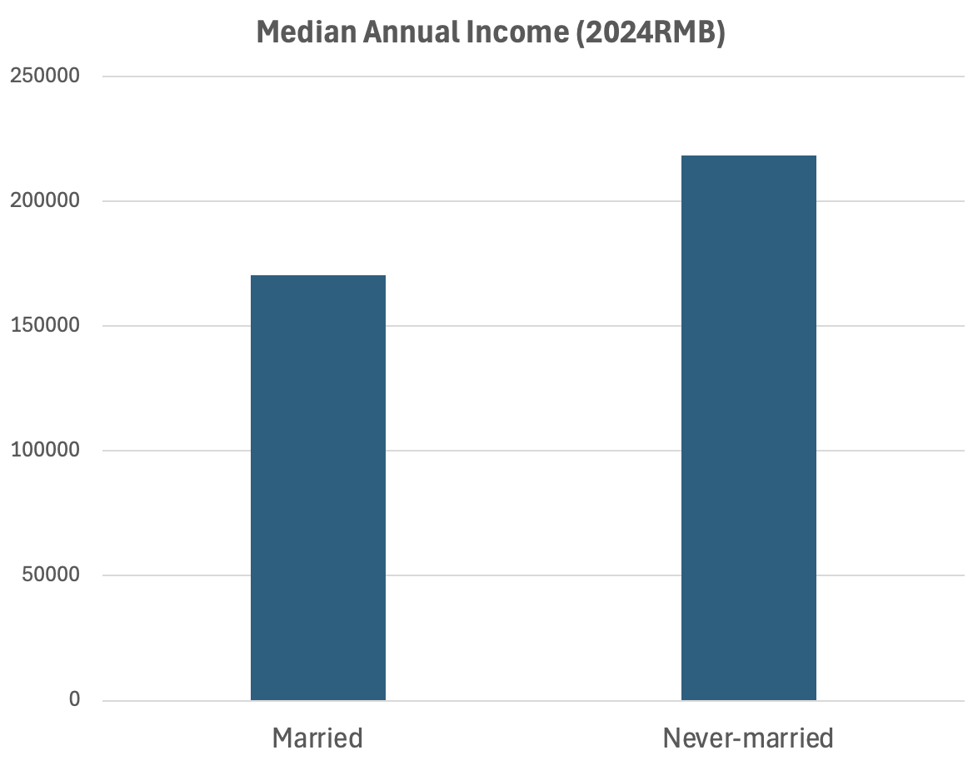
Marital condition
Families impose greater restrictions
on women
Career choices：
Women are more inclined to choose jobs that are more stable and less demanding.
Working hour options：
They prefer fixed working schedules to balance work and family care.
Childbearing responsibilities：
They spend more time taking care of their children, and choose to reduce their workload or even exit the workforce entirely.

Slide 9
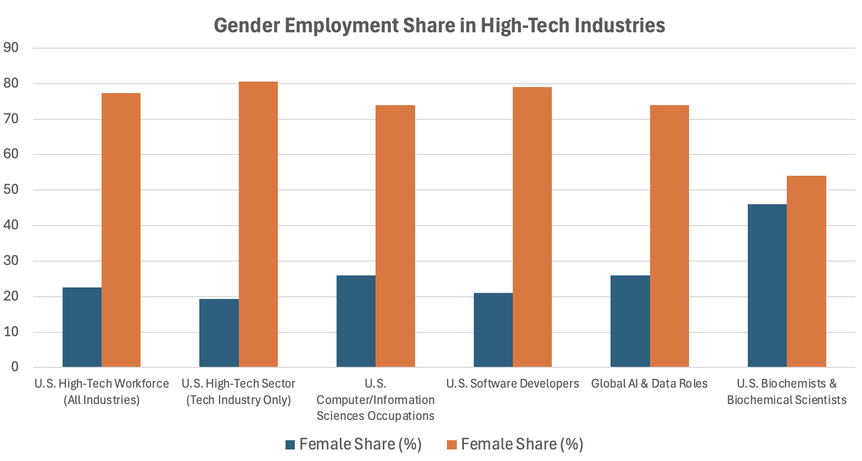
Requirements for practitioners in high-tech industries
Major constraints：
Women tend to choose liberal arts majors, which makes it difficult for them to secure jobs in high-tech industries
Industrial renewal：
The technologies in high-tech industries are updated and iterated at an excessively rapid pace.
Personal choices：
Influenced by objective physical conditions and emotional tendencies, women generally do not choose jobs with excessive pressure and high intensity.

Slide 10
Part 2 Conclusion

Slide 11
Why do fallacies arise？
Attempting to summarize data trends with a single cause leads to overgeneralization
The diversity of influencing factors has been ignored, and the issue has not been viewed comprehensively.
2. The foundational conditions for comparison are inconsistent.
Comparisons of subjects should be conducted under identical preconditions, and analyses should be carried out within the same dimension.
Marital status: married or unmarried?
Age group: homogeneity?
Educational background: consistency?
3. Data deception and misdirection
Individual differences are overlooked under the misleading influence of big data.

Slide 12

The gender pay gap is real, but its causes are more nuanced than we think.
By separating facts from fallacies, we can gain a more comprehensive understanding of the issue and make informed decisions.

Slide 13
Part 3
Q&A

Slide 14
reference
Our world in data: https://ourworldindata.org/economic-inequality-by-gender
People.cn：http://politics.people.com.cn/n1/2017/0307/c1001-29127762.html
National Bureau of Statistics (NBS), All-China Women's Federation (ACWF), 2024
U.S. EEOC (2024 Report)：Official U.S. federal agency data, 2014–2022 longitudinal tracking, most authoritative for U.S. high-tech gender gaps.
CompTIA (2025 Tech Workforce Report)：Leading tech industry trade group, industry-wide employment surveys, widely cited in tech diversity research.
Zippia (2024)：Labor market analytics platform using BLS/ACS microdata, reliable for occupation-specific gender breakdowns (biochemistry).
AIPRM/High5 (2025)：Aggregated industry reports, complementary to official data for AI/software roles.

Slide 15
Thank you for your listening
By: Jingliang lu

